Slide 1
TASK 3

Slide 2
REPORT
Title : Cross Side Scripting
Domain : vulnweb.com
Subdomain : testasp.vulnweb.com
Steps to Repoduce :
Step 1: Visit http://testasp.vulnweb.com/
Step 2: First register your self by clicking on the register option on the top menu bar.
Step 3: After registering , login to the website by clicking on the login option on the top menu bar.
Step 4: Click on the forums option present in the top menu bar.
Step 5: Then click on the Miscellaneous option in the forums page.
Step 6: Now click on the The Last Bug option in the Miscellaneous page.

Slide 3
Step 7: Now in the Message subject section and Message text section enter the same XSS code which is <scrpit>alert(1)</script>
Step 8: Then click the Post it button.
Impact: Cross site scripting can lead to stealing of your data and the user accounts may also be hijacked,credentials could be stolen,access to your clients computer can be obtained. This can be harmful or disastrous to your website/company.
Mitigation: If you want to prevent your website from being vulnerable to cross
side scripting then you have to take up some mitigation methods like:
a) Strictly filter the user input on arrival based on what is expected.
b) Use appropriate respose headers.
c) Validate the user inputs.
d) You can enable noscript on browser.

Slide 4
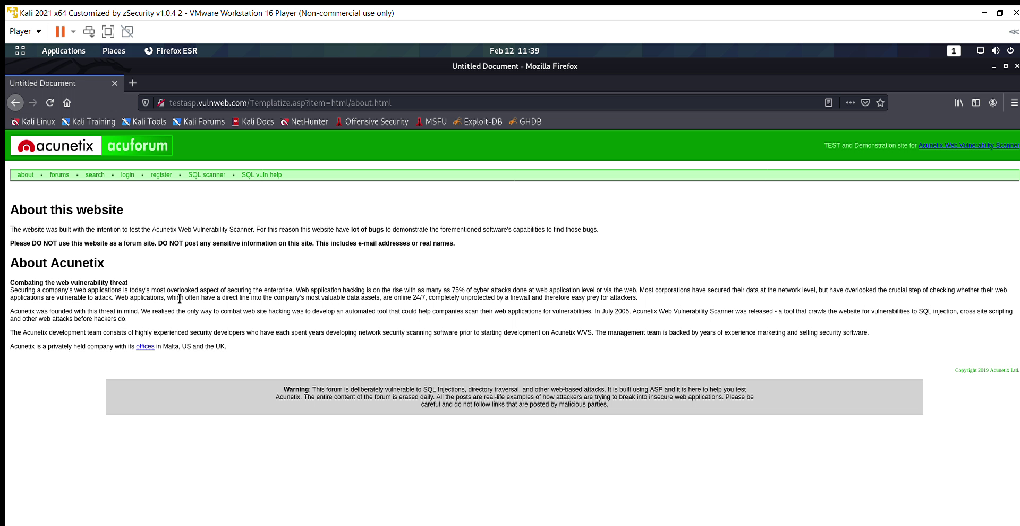
POC Video

Slide 5
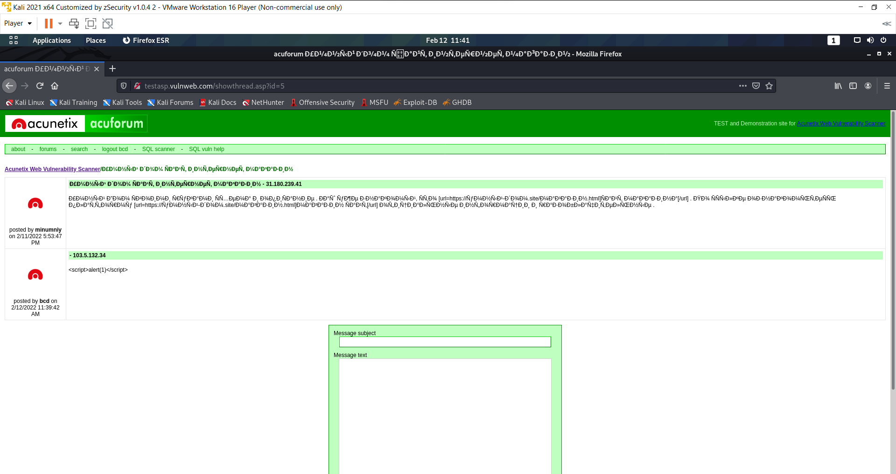
POC Screenshots

Slide 6
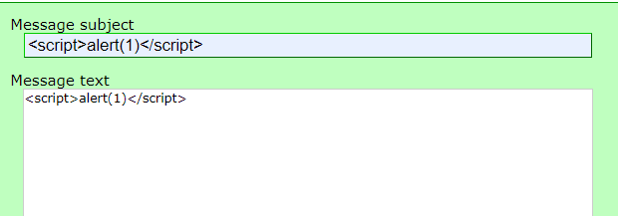

Slide 7
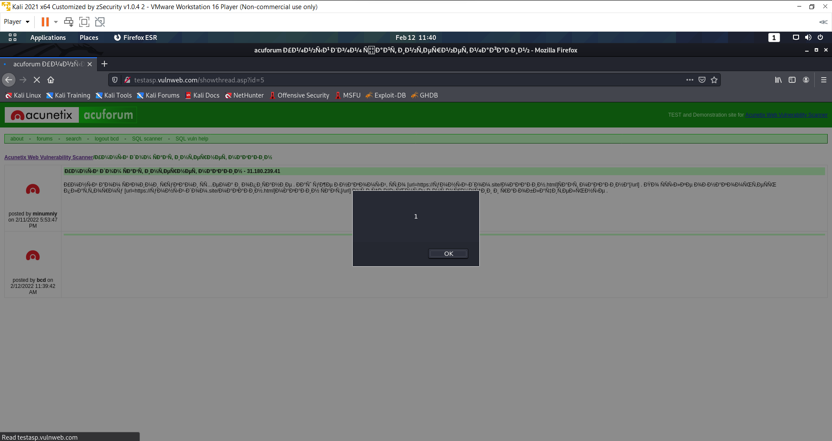

Slide 8
